Slide 1
Data Pre Processing
Siva

Slide 2
Data “cleaning”—This step deals with missing data, noise, outliers, and duplicate or incorrect records while minimizing introduction of bias into the database.
“Data integration”—Extracted raw data can come from heterogeneous sources or be in separate datasets. This step reorganizes the various raw datasets into a single dataset that contain all the information required for the desired statistical analyses.
“Data transformation”—This step translates and/or scales variables stored in a variety of formats or units in the raw data into formats or units that are more useful for the statistical methods that the researcher wants to use.
“Data reduction”—After the dataset has been integrated and transformed, this step removes redundant records and variables, as well as reorganizes the data in an efficient and “tidy” manner for analysis.

Slide 3
There are many factors comprising data quality, including accuracy, completeness, consistency, timeliness, believability, and interpretability.
Some part of data may have errors, unusual values, and inconsistencies in the data recorded for some transactions.
Examples: Wrong date formats, Incomplete data
Believability reflects how much the data are trusted by users, while interpretability reflects how easy the data are understood.

Slide 4
Data cleaning routines work to “clean” the data by filling in missing values, smoothing noisy data, identifying or removing outliers, and resolving inconsistencies.
Ex: Cust_Id and Custmer id referring to the same.
Data reduction obtains a reduced representation of the data set that is much smaller in
volume, yet produces the same (or almost the same) analytical results. Data reduction
strategies include dimensionality reduction and numerosity reduction.
In dimensionality reduction, data encoding schemes are applied so as to obtain a reduced or “compressed” representation of the original data.
Examples include data compression techniques (e.g., wavelet transforms and principal components analysis), attribute subset selection (e.g., removing irrelevant attributes), and attribute construction (e.g., where a small set of more useful attributes is derived from the original set).
In numerosity reduction, the data are replaced by alternative, smaller representations using parametric models (e.g., regression or log-linear models) or nonparametric models (e.g., histograms, clusters, sampling, or data aggregation).

Slide 5
Data cleaning – Missing values
Ignore the tuple: This is usually done when the class label is missing (assuming the mining task involves classification). This method is not very effective, unless the tuple contains several attributes with missing values.
Fill in the missing value manually: Time consuming
Use global constant for missing values: Can be replaced by ‘unknown’. Mining program can make mistake.
Use mean or median: For symmetric data, mean can be used and median for skewed data. Sometimes mean or median to the specific class or category ( Max. risk customers)
Most probable value: Use machine leanring or statistical procedure such as regression – Most popular and sensible

Slide 6
Noisy data
Smoothening – averaging removes noise.
Binning: Binning methods smooth a sorted data value by consulting its “neighborhood,” that is, the values around it. The sorted values are distributed into a number of “buckets,” or bins. Because binning methods consult the neighborhood of values, they perform local smoothing.
In smoothing by bin means, each value in a bin is replaced by the mean value of the bin. For example, the mean of the values 4, 8, and 15 in Bin 1 is 9. Therefore, each original value in this bin is replaced by 9.
Similarly, smoothing by bin medians can be employed, in which each bin value is replaced by the bin median. In smoothing by bin boundaries, the minimum and maximum values in a given bin are identified as the bin boundaries. Each bin value is then replaced by the closest boundary value.
Regression can be used to represent the data by a few parameters.

Slide 7
Data integration
During data integration, entity recognition ffrom various sources. (Cust_id and customer id)
Redundancy and correlation
Redundancy is another important issue in data integration. An attribute (such as annual revenue, for instance) may be redundant if it can be “derived” from another attribute or set of attributes.
Some redundancies can be detected by correlation analysis. Given two attributes, such analysis can measure how strongly one attribute implies the other, based on the available data.
For nominal data, we use the 2 (chi-square) test. For numeric attributes, we can use the correlation coefficient and covariance, both of which access how one attribute’s values vary from those of another.

Slide 8
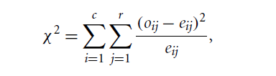
Chi square correlation (Nominal data)
Let Ai, Bj be two events.A has ‘c’ distinct values and B has ‘r’ distinct values.
Let oij be the observed frequency of the combination of Ai and Bj.
Let eij – expected frequency (=count(Ai) * Count(Bj)/n ) where n is the number of tuples.
The Pearson statistic(Chi square) is given by
The chi square purely depends on degrees of freedom. In case of 2 X 2 table, it is (2-1) * (2-1) =1 . The needed chi square is predefined. Example is given in the reference.

Slide 9
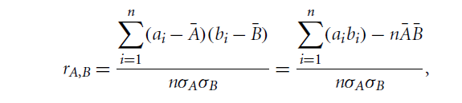
Correlation coefficient
where n is the number of tuples, ai and bi are the respective values of A and B in tuple i,
ABAR and BBAR are the respective mean values of A and B, σA and σB are the respective standard deviations of A and B.
If the resulting value is close to Zero, then there is no correlation.
A and B are highly correlated does not mean A causes B or B causes A. Infact booth might have been caused by another unknown C.
Sameway covariance analysis can be used.

Slide 10
Data reduction
Dimensionality reduction Principal component analysis
Numerosity reduction (smaller forms of data representation): Regression and log linear models
Non parametric – Clustering , Histograms and sampling
Attribute subset selection:
Attribute subset selection reduces the data set size by removing irrelevant or redundant attributes (or dimensions).
The goal of attribute subset selection is to find a minimum set of attributes such that the resulting probability distribution of the data classes is as close as possible to the original distribution obtained using all attributes.

Slide 11
The “best” (and “worst”) attributes are typically determined using tests of statistical significance, which assume that the attributes are independent of one another. Many other attribute evaluation measures can be used such as the information gain measure used in building decision trees for classification

Slide 12
Data transformation
1. Smoothing, which works to remove noise fromthe data. Techniques include binning, regression, and clustering.
2. Attribute construction (or feature construction), where new attributes are constructed and added from the given set of attributes to help the mining process.
3. Aggregation, where summary or aggregation operations are applied to the data. For example, the daily sales data may be aggregated so as to compute monthly and annual total amounts. This step is typically used in constructing a data cube for data analysis at multiple abstraction levels.
4. Normalization, where the attribute data are scaled so as to fall within a smaller range, such as --1.0 to 1.0, or 0.0 to 1.0.
5. Discretization, where the raw values of a numeric attribute (e.g., age) are replaced by interval labels (e.g., 0–10, 11–20, etc.) or conceptual labels (e.g., youth, adult, senior). The labels, in turn, can be recursively organized into higher-level concepts, resulting in a concept hierarchy for the numeric attribute. Figure 3.12 shows a concept hierarchy for the attribute price. More than one concept hierarchy can be defined for the same attribute to accommodate the needs of various users.
6. Concept hierarchy generation for nominal data, where attributes such as street can be generalized to higher-level concepts, like city or country. Many hierarchies for nominal attributes are implicit within the database schema and can be automatically defined at the schema level.

Slide 13
Data normalization
To help avoid dependence on the choice of measurement units, the data should be normalized or standardized.
This involves transforming the data to fall within a smaller or common range such as [-1, 1] or [0.0, 1.0]. (The terms standardize and normalize are used interchangeably in data preprocessing.
Normalizing the data attempts to give all attributes an equal weight. Normalization is particularly useful for classification algorithms involving neural networks or distance measurements such as nearest-neighbor classification and clustering.

Slide 14

Min-max normalization performs a linear transformation on the original data. Suppose that minA and maxA are the minimum and maximum values of an attribute, A.
Min-max normalization maps a value, vi , of A to vi’ in the range [new minA,new maxA] by computing
Min-max normalization preserves the relationships among the original data values. It will encounter an “out-of-bounds” error if a future input case for normalization falls outside of the original data range for A.

Slide 15
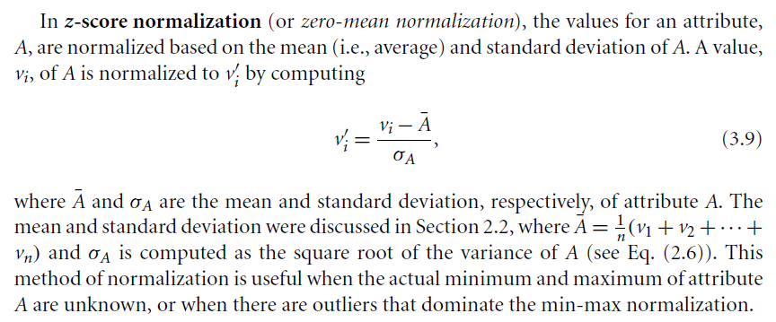

Slide 16
Discretization
Clustering and decision tree are described later.

Slide 17
Concept hierarchy

